Slide 1
muParser API for LabVIEW
A faster math expression parser for LabVIEW
Ryan Porter, P.Eng.
porter@canterautomation.com
porter on lavag.org

Slide 2
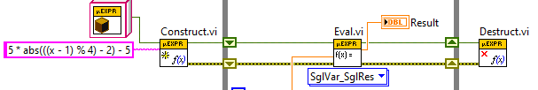
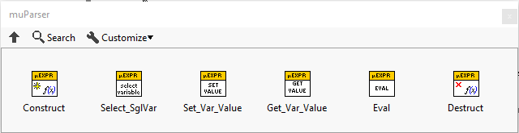
What is it?
A LabVIEW wrapper for the muParser math expression parser
Parse and evaluate math expressions at runtime
Open source, BSD 2-Clause license.
Github: github.com/rfporter/LV-muParser
VIPM: vipm.io/package/lv_muparser
Tested on Windows, Ubuntu Linux, and RT Linux
Documentation path
<LabVIEW>\vi.lib\LAVA\muParser
Similar to:
NI Formula Parsing (NI_GMath lib)
GPower Expression Parser

Slide 3
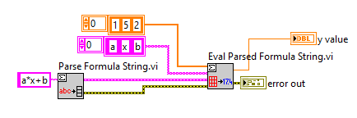
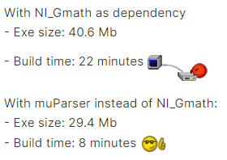
NI Formula Parser
Only variables a..z,a0..z9 are valid
Logical and equality operators are not valid ( ||, &&, !=, ==, >, <, >=, <= )
Bitwise operations are not valid ( and, or, xor )
Variable names are not output from the parsing routine.
Part of the massive NI_Gmath library

Slide 4

muParser
Math expression parser library written in C++
Open source, BSD 2-Clause license.
Github: github.com/beltoforion/muparser
Can define custom constants, functions and operators
LabVIEW can call it via DLL interface

Slide 5
muParser DataTypes
Base data type is double precision floating point (64-bit IEEE 754)
Bitwise operations will convert the input values to 32-bit unsigned integer to perform the operation. The return value is in double precision floating point
Values specified in hexadecimal (starting with 0x) or binary (starting with 0b) are interpreted as 32-bit unsigned integers.

Slide 6
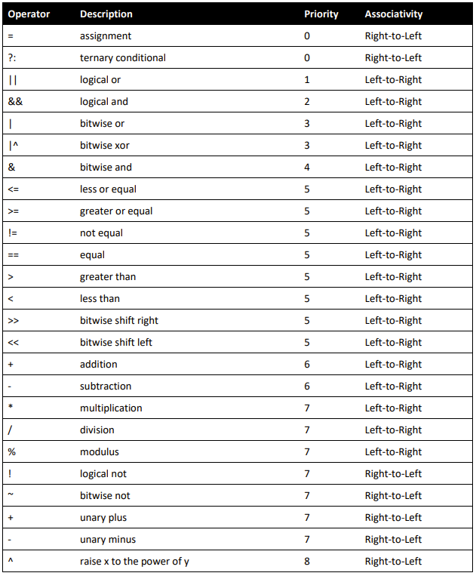
muParser Operators
Bitwise operators, logical not, and modulus are custom additions to the DLL shipped with API for LabVIEW

Slide 7
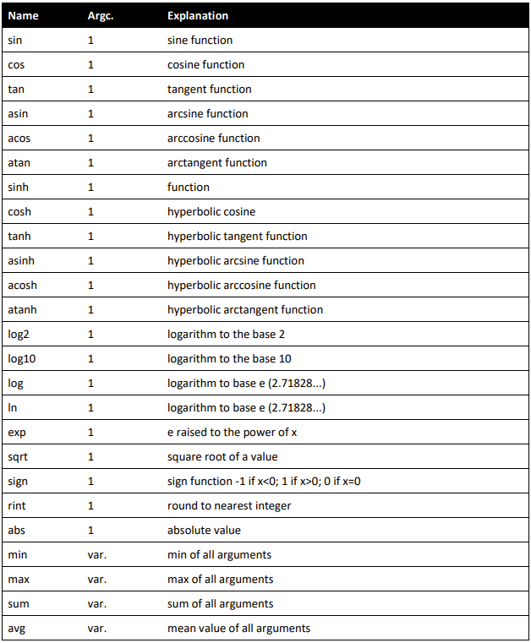
muParser Functions

Slide 8

muParser variables and constants
Pi and e are pre-defined constants
Names are case-sensitive
Valid characters are
a..z
A..Z
0..9
:
_
Maximum length 100 characters

Slide 9
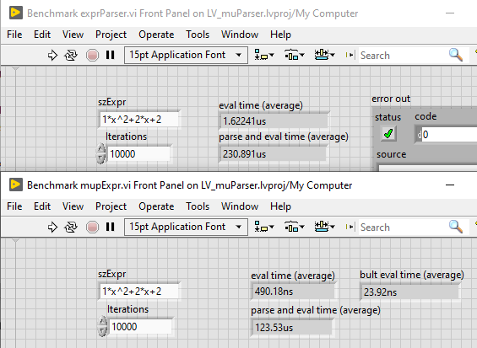
muParser Performance
NI Parser
muParser

Slide 10
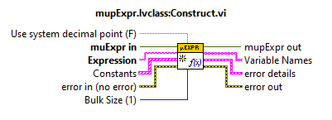
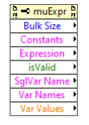
muParser for LabVIEW
Expression is parsed during construct of the muExpr instance
Set_Var_Value, Get_Var_Value, Eval are polymorphic
Destruct must be called on the muExpr instance in order to release system resources

Slide 11






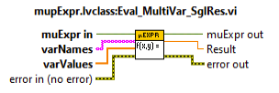
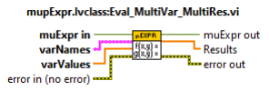

Eval Modes
Single Result
Multiple Results
Bulk Mode
No Variable Update
Single Variable Update
Multi-Variable Update

Slide 12
Examples

